Slide 1

School of Computer Science And Engineering Department of Artificial Intelligence
Minor Project Presentation-I
on
Title: HAND GESTURE BASED VOLUME CONTROL
Presented By: Sankalp Dutta , Siddhant Upadhyay , Priyanshu Baliyan
Section:- D
Supervised By: Mr. Surendra Solanki
Designation: Assistant Professor

Slide 2
Agenda/ contents
Introduction
Problem Statements
Requirements Engineering
Design/ Development
Timestamp
References

Slide 3
Introduction
Introducing a cutting-edge endeavor in human-computer interaction, our project pioneers a revolutionary method for volume control utilizing hand tracking models.
By leveraging advanced algorithms capable of tracking thumb and index finger movements, we aim to redefine the conventional means of adjusting audio levels.
Gone are the days of fumbling with buttons or dials; instead, users can effortlessly modulate volume with intuitive hand gestures

Slide 4
Problem Statements
These days the buttons on the electronic devices that we use daily may malfunction and become unresponsive due to several factors like faulty hardware's, outdated drivers, dust and incorrect key settings.
To correct this, we may update some drivers which may lead to more malfunctioning
So, to tackle this why don’t we add some advanced functionalities rather than fixing the complicated ones.

Slide 5
Requirements Engineering
Software:
- Python (programming language) - OpenCV (computer vision library) – math - time
Hardware: -
GPU (Graphics Processing Unit) for accelerated training (optional but recommended) - Webcam or video input device for real-time gesture recognition

Slide 6
Design/ Development
SOME METHODOLOGY
Hand Detection and Tracking: - Hand Detection and Tracking: Utilize computer vision techniques to detect and track the user's hand in real-time. This involves selecting appropriate algorithms and frameworks (e.g., OpenCV, Media Pipe) to accurately locate and follow the hand's movements.
Gesture Recognition: - involves preprocessing input data, detecting hands in the image, detecting hand landmarks, and recognizing hand gesture from the landmarks.

Slide 7
Testing and Evaluation: - Conduct rigorous testing to assess the accuracy, responsiveness, and reliability of the gesture-controlled volume system. This includes both simulated testing and real-world usage scenarios to identify and address any issues or limitations. - Thorough testing on diverse datasets to assess model generalization and robustness across different scenarios and conditions.
Deployment and Integration: - Integrate the model into user-facing applications and platforms, ensuring seamless interaction and compatibility with existing systems. - Solicit feedback from users and stakeholders to identify areas for improvement.

Slide 8
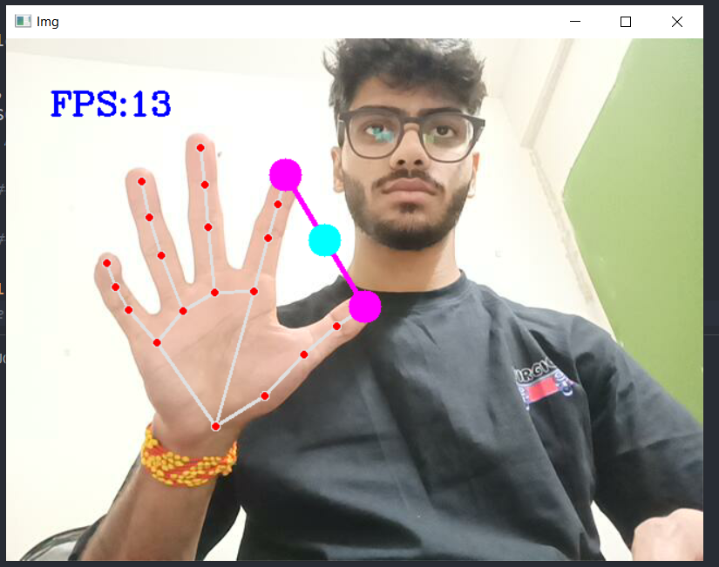
SOME sNIppets

Slide 9
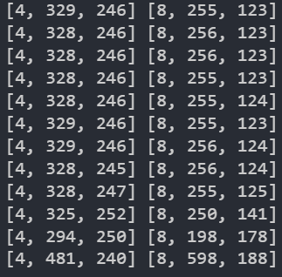
These are the coordinates of the points that
Are marking the hand and kept on changing
while our hand is in motion.

Slide 10
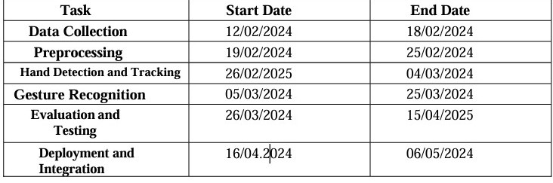
TimeLine of project

Slide 11
references
Li, C. T., & Nixon, M. S. (2004). Hand Gesture Recognition Using Shape Context Matching. Proceedings of the IEEE International Conference on Pattern Recognition.
2. Pu, J., & Black, M. J. (2020). Mocap-guided Data Augmentation for 3D Hand Pose Estimation. Proceedings of the European Conference on Computer Vision (ECCV).
3. Kolsch, H., Turk, A., & Burkhardt, H. (2005). Hand Gesture Recognition Based on Local Features: A Combination of Finger Posing and Movements. Proceedings of the IEEE Workshop on Automatic Identification Advanced Technologies (AutoID).
4. https://www.computervision.zone/courses/gesture-volume-control

Slide 12
Thank You

